Slide 1
STUDENT INTERESTS SYSTEM
SUBMITTED BY: Rijwa Ali

Slide 2
STUDENT INTEREST SYSTEM
The Student Interest System is a web application built using Python Flask, MySQL Workbench. It provides a user-friendly interface for managing student information efficiently in educational institutions.

Slide 3
Key Features:
1. User Authentication: Secure login/signup mechanism for authorized access.
2. Dashboard: Visualizes significant statistics with charts like pie charts, line charts, and tables.
3. Student Interest Page: Allows addition and dynamic selection of student interests.
4. Student List View: Displays paginated tabular data with CRUD operations.
5. Data Export: Enables exporting student data to Excel for analysis.
6. Charts and Visualizations: Provides insights into demographics, interests, and system activity.
7. Activity Log: Displays system activity on the dashboard.

Slide 4
Technology Stack
Backend: Python Flask
Frontend: HTML & CSS
Database :MySQL Workbench
Implementation:-
Login/Signup:Basic login/signup functionality with minimal features.
Dashboard: Charts and tables representing student data.
Student List View: Paginated view with CRUD operations.
Add New Student: Form for adding student data with validations.

Slide 5
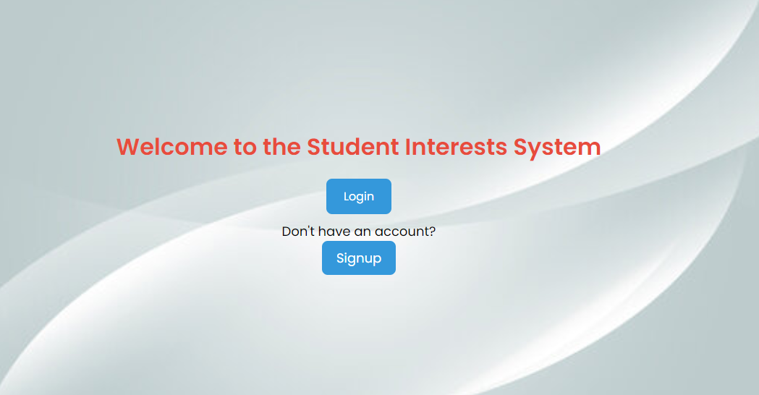

Slide 6
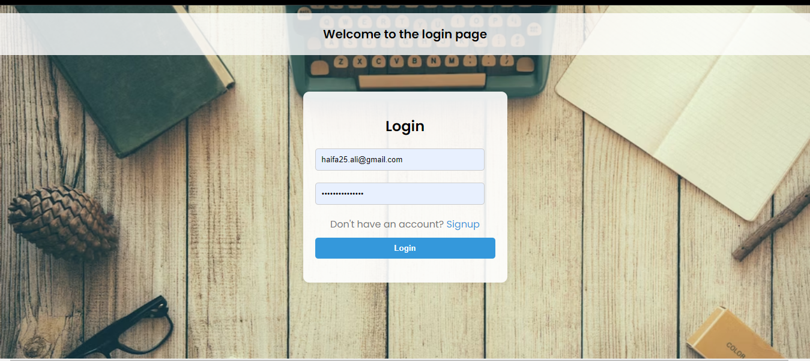

Slide 7
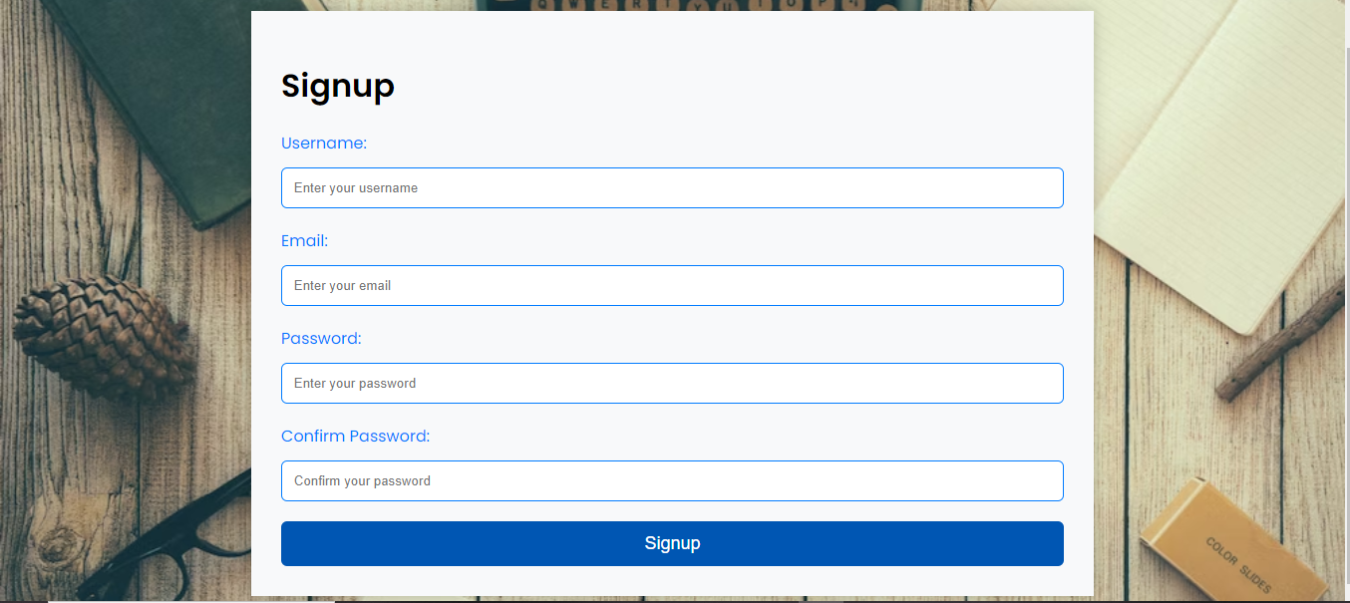

Slide 8
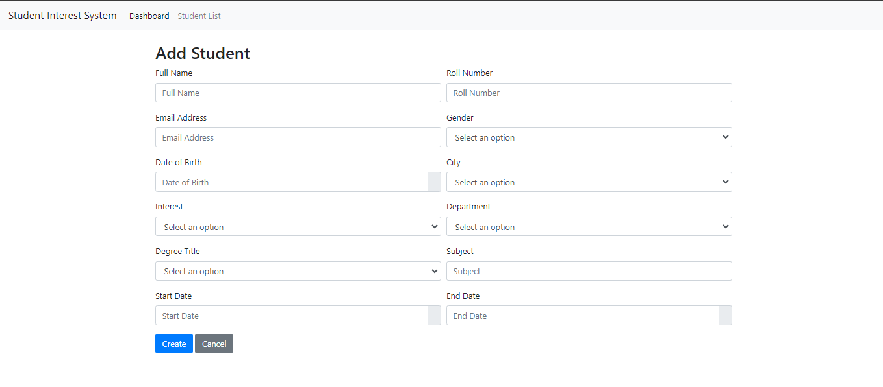

Slide 9
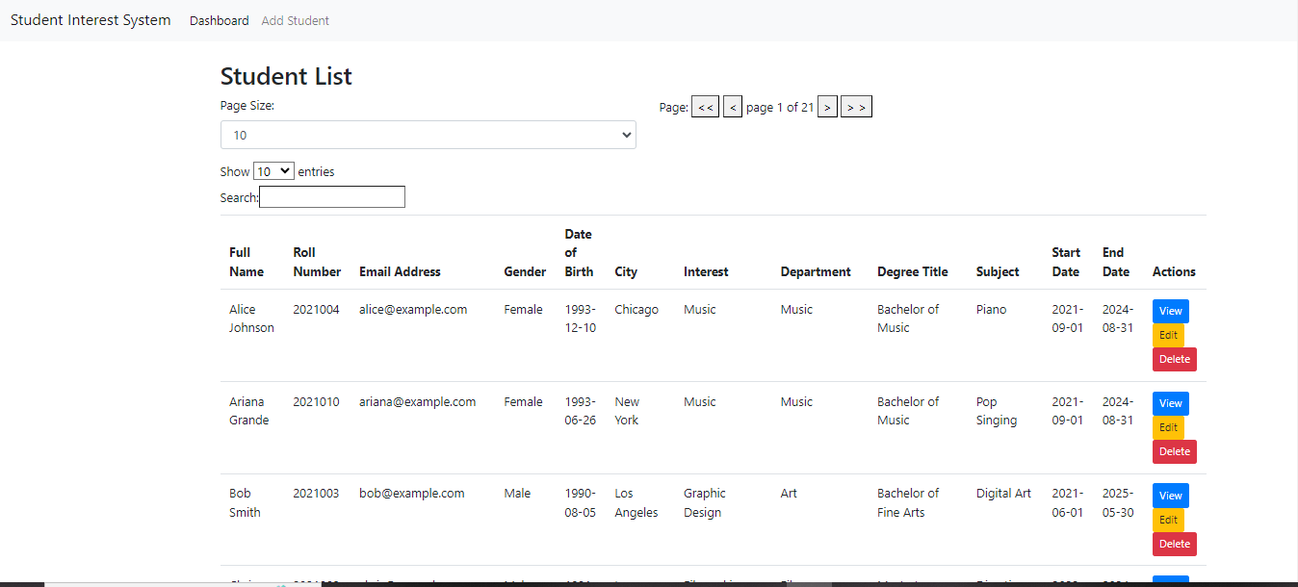

Slide 10
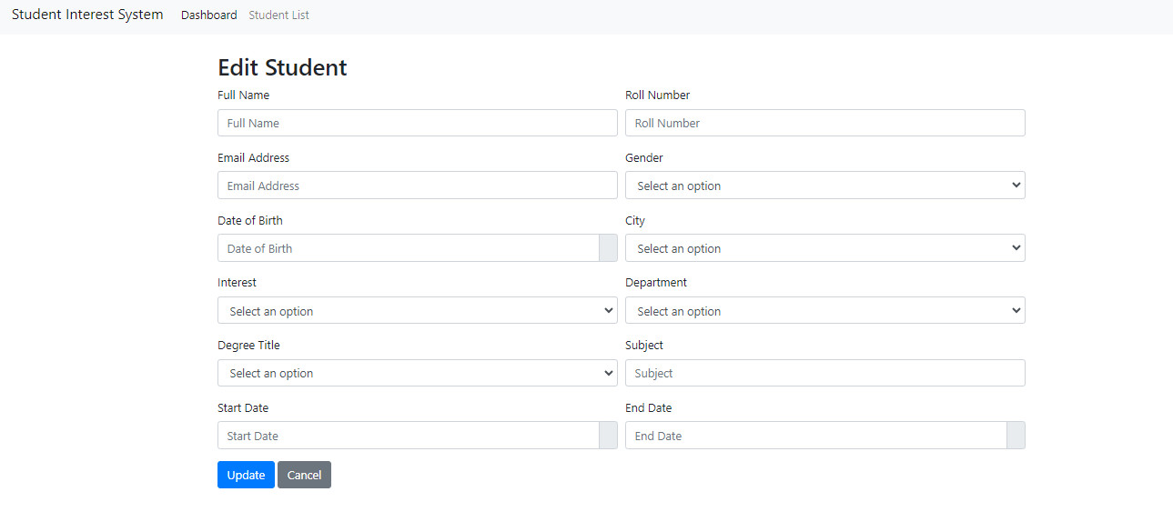

Slide 11
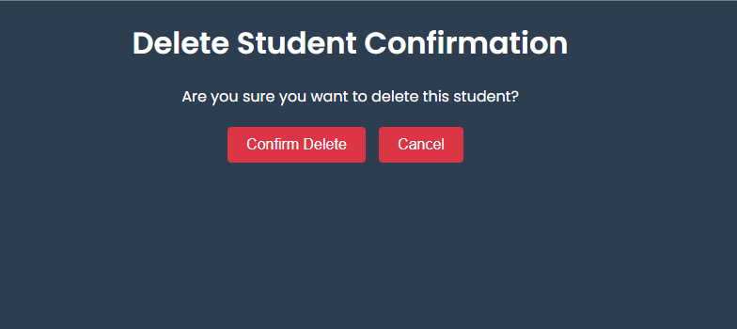

Slide 12
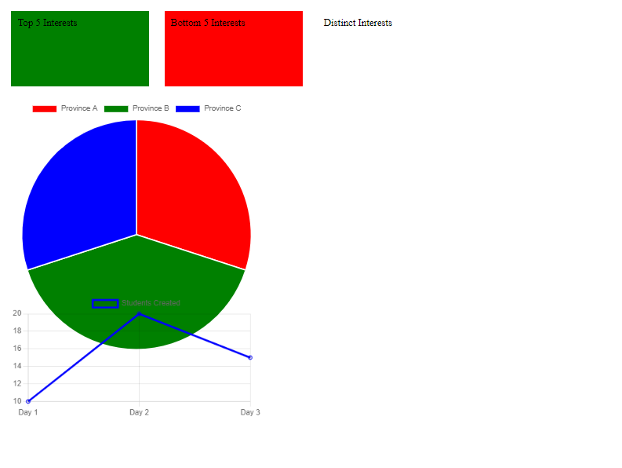

Slide 13
